Slide 1
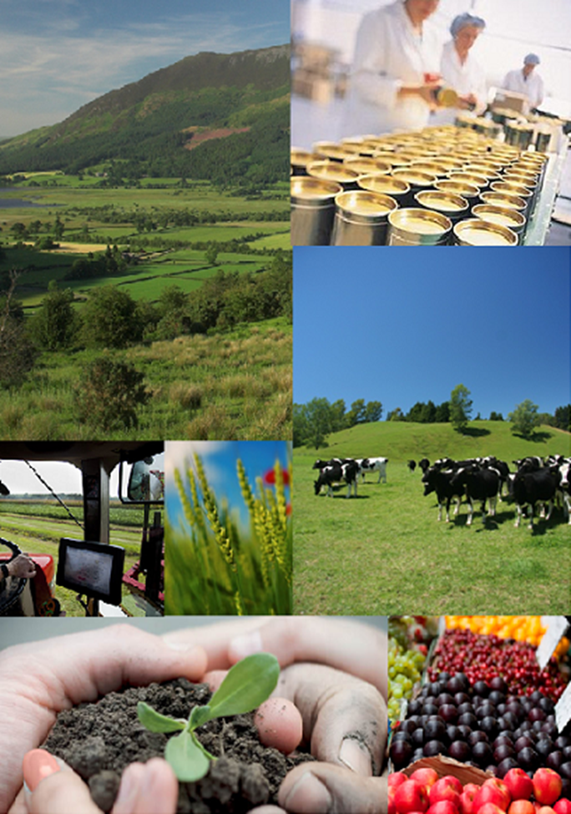
The new CAP-making EU farming smart and sustainable
Mihail DUMITRU
Deputy Director General
DG Agriculture and Rural Development
European Commission
Conference on Sustainable Farming
Budapest, 18th October 2017

Slide 2
OUTLINE
1. The CAP: promoting sustainable farming
2. The need to improve
3. The CAP in the future: modernisation and simplification

Slide 3
SUSTAINABILITY
Sustainable Agriculture
and Rural Development
Economic Viability
Social Acceptability
Environmental Integrity

Slide 4
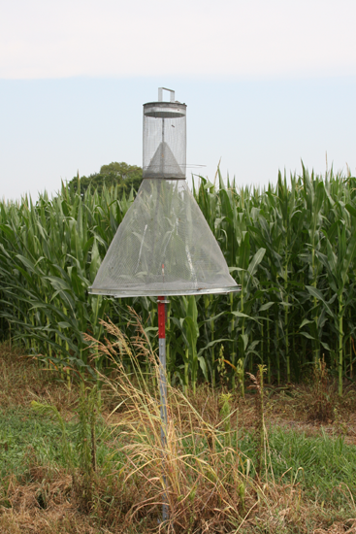
The CAP: Promoting sustainable farming
A long-term objective
Evolution and adaptation
Growing share of budget is sustainability-related
Wide toolkit available
But increased complexity

Slide 5
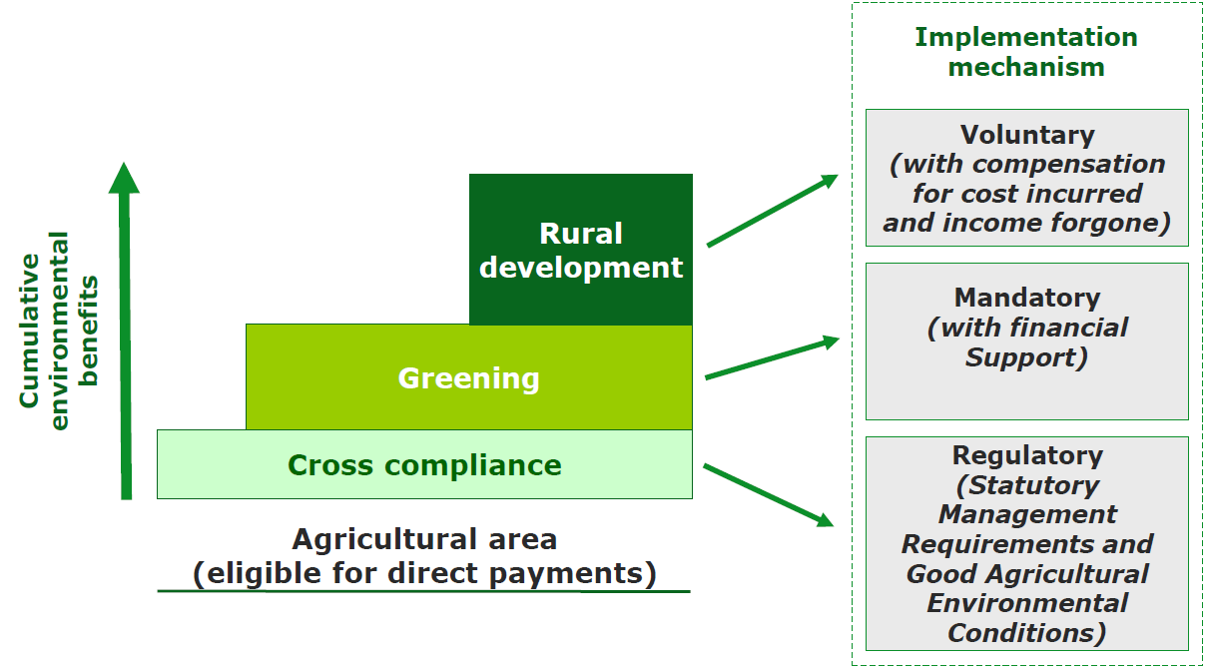
CAP tools for sustainability

Slide 6
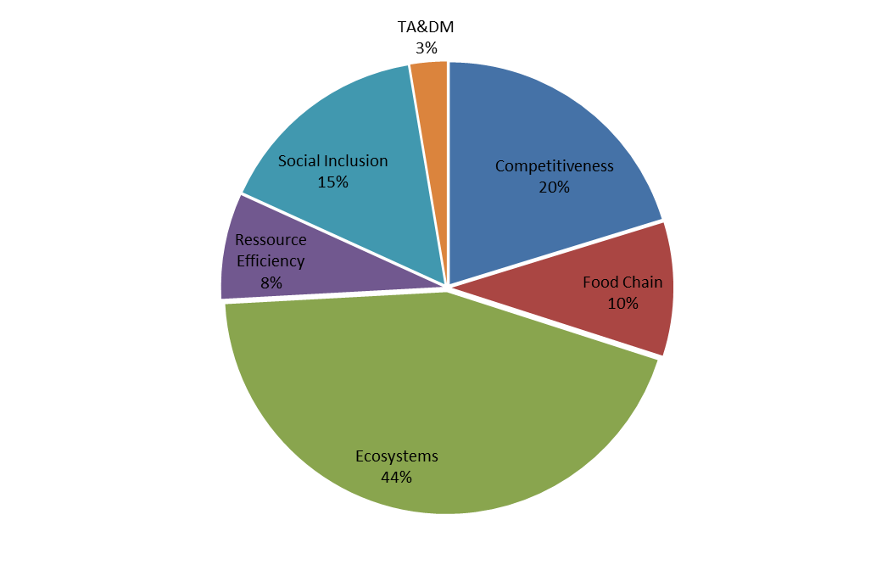
CAP tools - Share of funds per RD priority
Knowledge Transfer and Innovation (cross cutting)
18 Focus Areas
Farm viability competitiveness,
sustainable forest management
Food chain organisation, animal
welfare, risk management
Ecosystems in agriculture and forestry
Resource efficiency, low carbon
and climate resilience
Social inclusion, poverty reduction, economic development
6

Slide 7
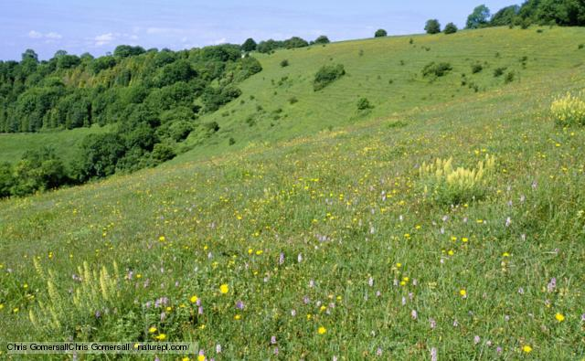
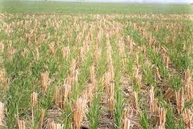
CAP tools for sustainability
Extensification of crops and permanent grassland (AECM, in part greening and environmental cross-compliance)
Conservation agriculture practices on soil (AECM)

Slide 8
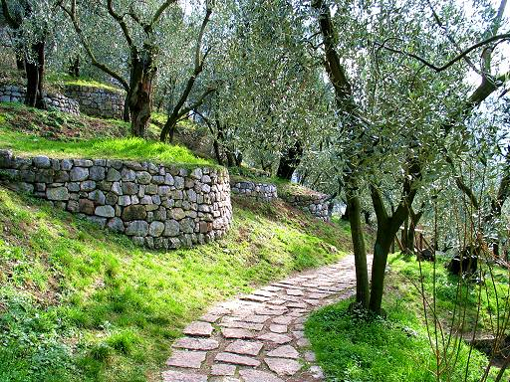
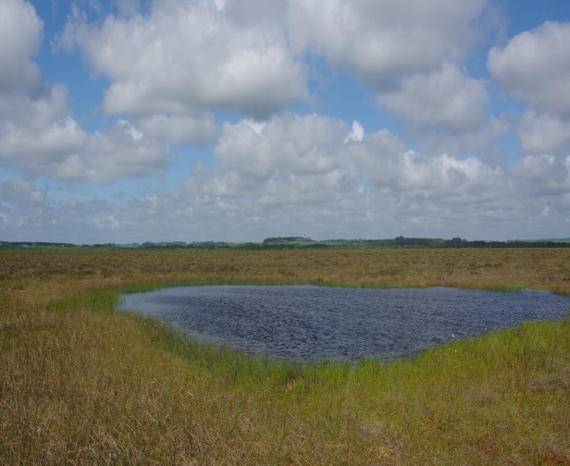
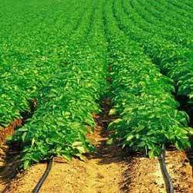
CAP tools for sustainability
Non-productive investments (e.g. agriculture dry walls, wetlands, hedges, tree lines, ponds, bosquets)
Investment in irrigation to reduce water consumption

Slide 9

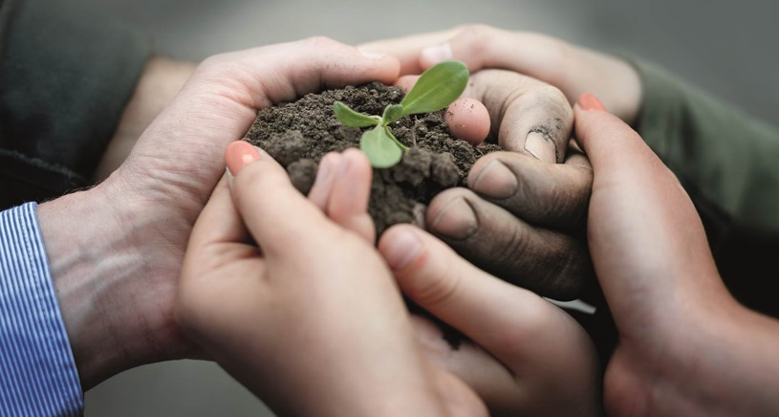
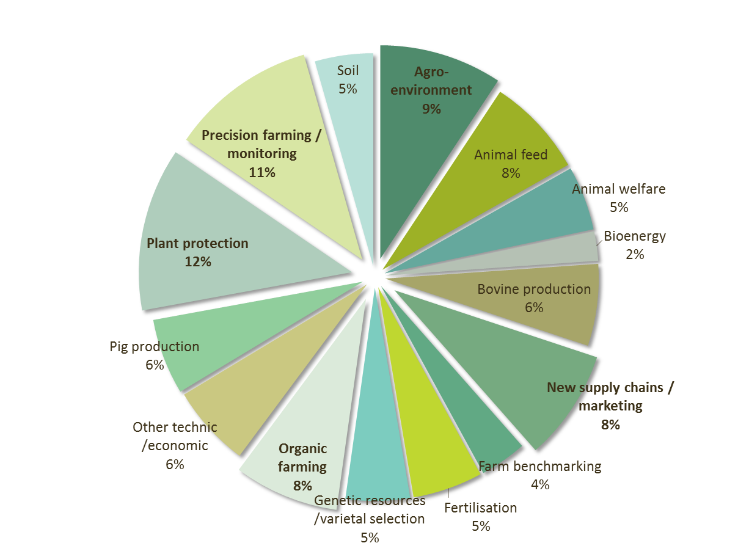
CAP tools for sustainability
The European Innovation Partnership for agriculture productivity and sustainability (EIP-AGRI)
3200 operational groups = multi-actor projects creating innovations
Networking & knowledge exchange

Slide 10
CAP tools for sustainability
simplification agenda
Changes to Greening Rules:
- Simplification of greening provisions
- Ban on pesticides and fertilisers on EFA
"OMNIBUS" Regulation
- Simplification
- Clarifications (e.g. Permanent Grassland)
- Facilitation of Financial Instruments for investment support
OTHER (IAs, revision of guidance docs)

Slide 11

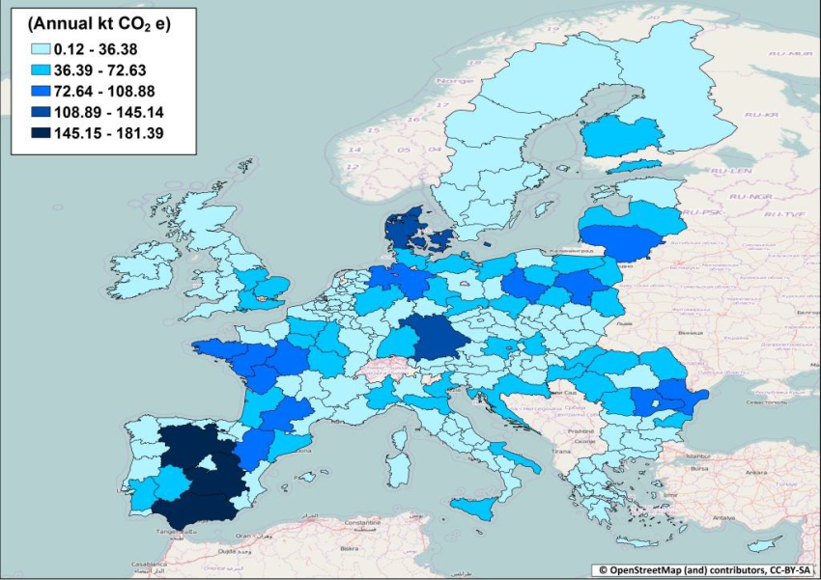
The need to improve….
Global commitment to transition to a low-emission economy, holding the increase in the global temperature to well below 2 °C
Entered into force 4 November 2016
Grassland
Management
is crucial for
Climate Change
mitigation

Slide 12
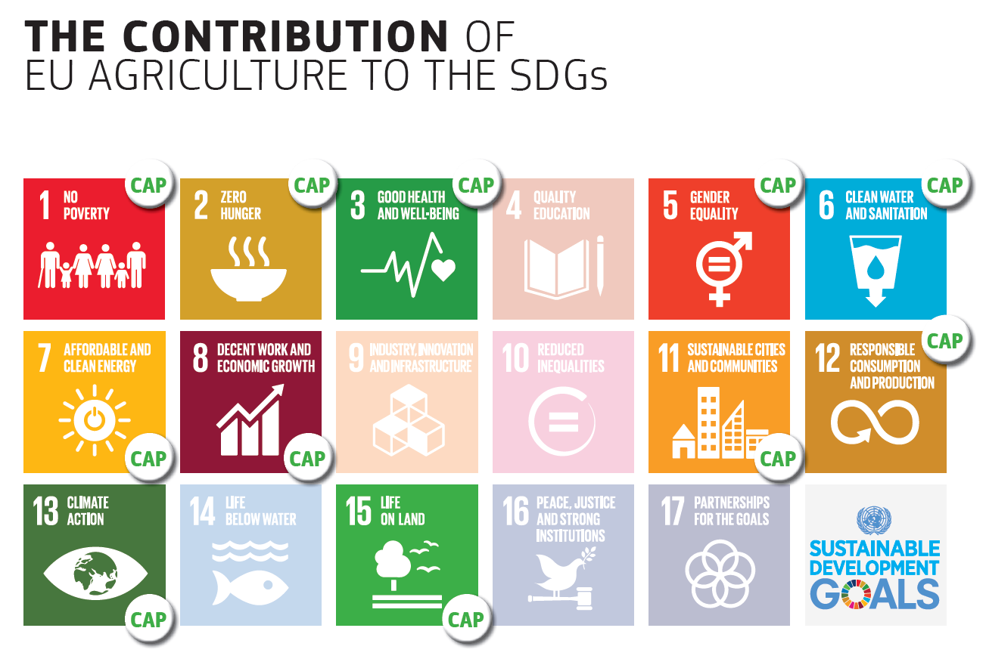
The need to improve……..
Sustainable Development Goals

Slide 13










Rural policies must contribute to Commission Priorities
1. Jobs, Growth and
Investment
2. Digital Single Market
3. Energy und Climate
4. Single Market
5. Economic and Monetary Union
6. Free Trade with US
7. Justice and Fundamental Rights
8. Migration
9. EU as a stronger global Actor
10. Democratic Change

Slide 14
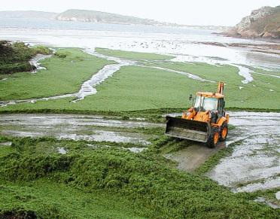
The need to improve……..
EU agriculture is responsible of 45% of water pollution
(SDG 6: ensure availability and sustainable management of water and sanitation for all)
Water shortage – irrigation technology innovation is helping
EU biodiversity declined inter alia because of agricultural activity, but existing biodiversity depends on agriculture
(SDG 15: protect, restore and promote sustainable use of terrestrial ecosystems, sustainably manage forests, combat desertification, and halt and reverse land degradation and halt biodiversity loss)
EU conservation agriculture practices to protect soils
EU agricultural emissions contribute to Climate change, but agriculture is a fundamental tool to mitigate climate change
(SDG 13: Take urgent action to combat climate change and its impacts)

Slide 15
The need to improve….
Complexity of the final legislation left all parties involved unsatisfied with the final result
=> CAP simplification
Rapid changes in the broader environment surrounding EU agriculture – from markets and trade to climate change and environmental challenges
=> CAP modernisation
15

Slide 16
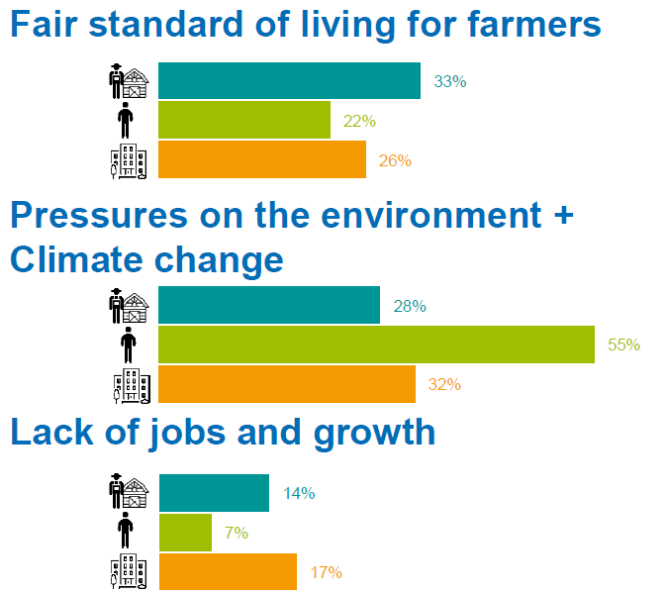
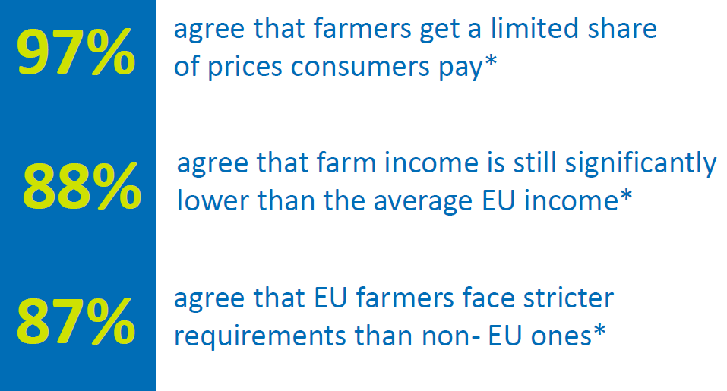
The need to improve……
16

Slide 17
The CAP in the future: Cross-cutting challenges
Contribution to EU priorities and SDGs, Policy Coherence
Subsidiarity / EU added value
Simplification
Budget focused on results

Slide 18
The CAP in the future: Objectives
Economic
Foster a smart and resilient agricultural sector
Environmental
Enhance environmental sustainability and
climate-resilience
Strengthen the socio-economic fabric of rural areas (including generational renewal)
Social
Cross-cutting
More subsidiarity
More Knowledge
18

Slide 19
Thank you for your attention!

